Slide 1
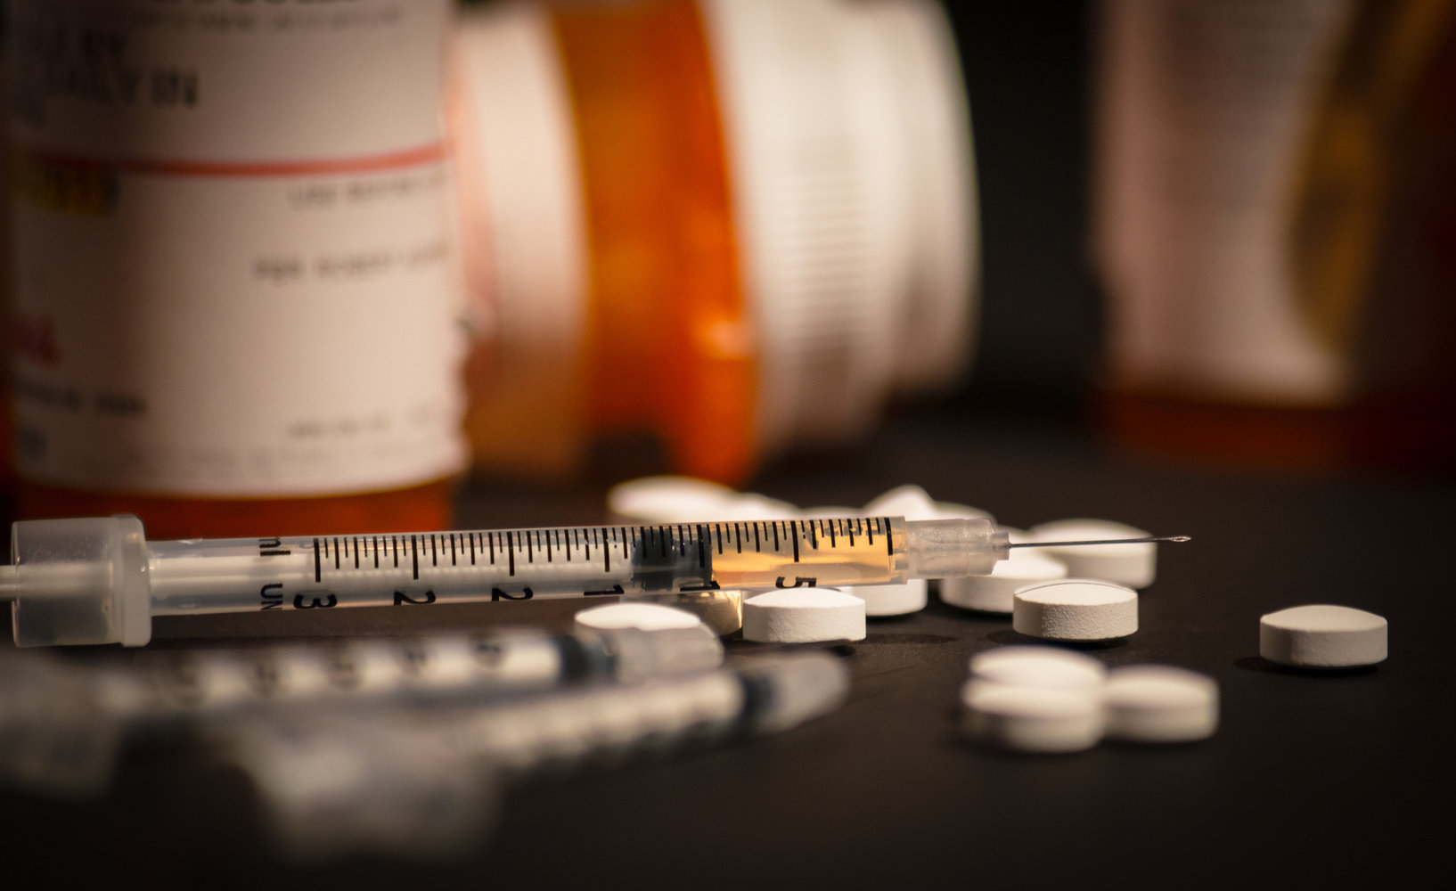
TRENDS IN DRUG OVERDOSES IN THE UNITED STATES
GROUP 12
Prepared by Shimsy Varkey, Sam Jebreen, Justin Chow, Zhanna Kirbakayeva

Slide 2
PROJECT DESCRIPTION
This project is intended to analyzes the CDC's drug overdose death rate in the United States.
THE CDC | HEALTHDATA.GOV
Notes:
Deaths from drug overdose continue to contribute to mortality in the United States. In the past 3 decades, drug overdoses have killed approximately 870,000 people. Since first wave of the opioid epidemic began in the 1990s, the epidemic has expanded to include other synthetic, illicit drugs, including heroin and fentanyl. This dataset stratified by key categories:
Month and Year (available from January 2016 thru December 2019)
Drug types (Cocaine, Heroin, Meth, prescription opioids, psychostimulants)

Slide 3
ACCUMULATED DRUG DEATHS IN THE U.S. [2016-2019]
Notes:
Data has demonstrated that the overdose epidemic is spreading geographically and increasing across the U.S. Drug overdose killed 13137621 since 2016.

Slide 4
PRESCRIPTION DRUGS OVERDOSE RATES ARE HIGHER AMONG THE OTHER DRUG TYPES
Notes:
While methadone related deaths have begun to decrease slightly across the United States. Opioids continue to drive overdose death rates.

Slide 5
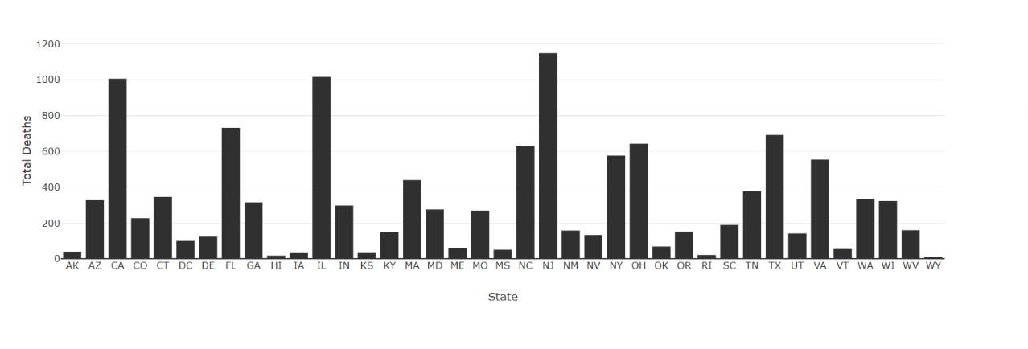
FULL STATE GRAPH FOR DRUG TYPE AND YEAR

Slide 6
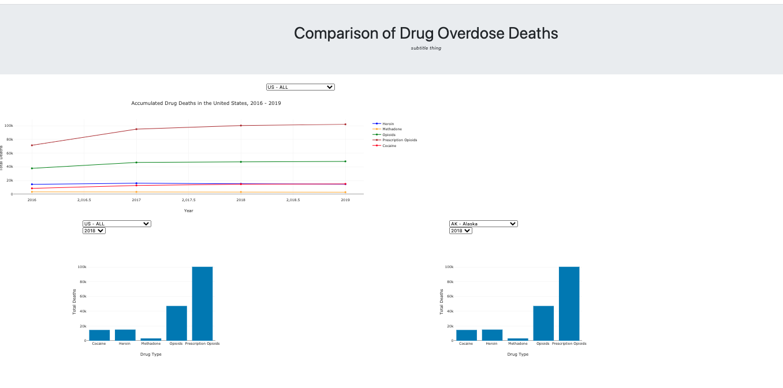
HEROKU DEPLOYMENT
http://drug-study.herokuapp.com/
This project is intended to analyzes the CDC's drug overdose death rate in the United States.
THE CDC | HEALTHDATA.GOV
Notes:
[How Heroku deployment with flask was accomplished and what steps have been taken.].

Slide 7
OBSERVATIONS
The CDC data were encouraging for some states that have historically been hit hardest by the epidemic. For example, drug overdose deaths in Ohio dipped 22.4% from 5155 to 4002 between the 12-month period ending December 2017 and the 12-month period ending December 2018. Rates in Pennsylvania dropped 19.6% from 5600 to 4503 during the same time period.
Other states that saw increases include California, South Carolina, Vermont, Louisiana, and Arizona.

Slide 8

THANK YOU
2
+
2
+

